Slide 1
Implementation Object Linking and Embedding for Processes Control Unified Architecture Specification on Secure Device
The future standard for communication and information modeling in automation
Yuankui Wang

Slide 2
Agenda
System Design
Implementation and Test
Security Concerns

Slide 3
System Design: Overview

Slide 4
System Design: Android UI Class

Slide 5
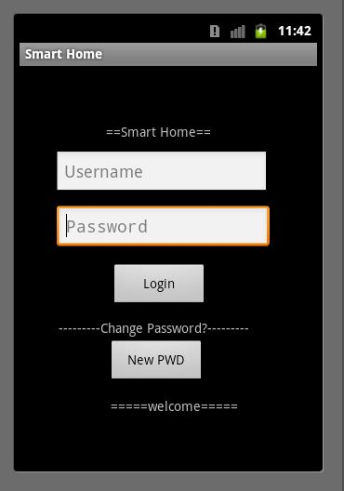
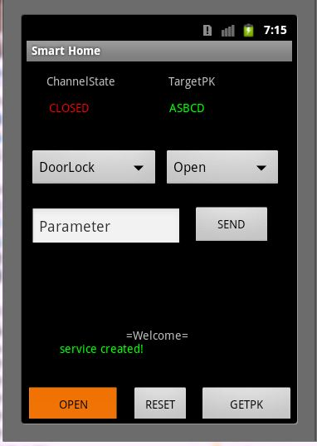
System Design: Android UI

Slide 6
System Design: Android UI
DoorLock
Open
GetRecord
GrantAccess
Sensor:
GetValue
SetSubscrition
GetRecord
CafeMaker
AddWater
AddCafe
MakeCafe

Slide 7
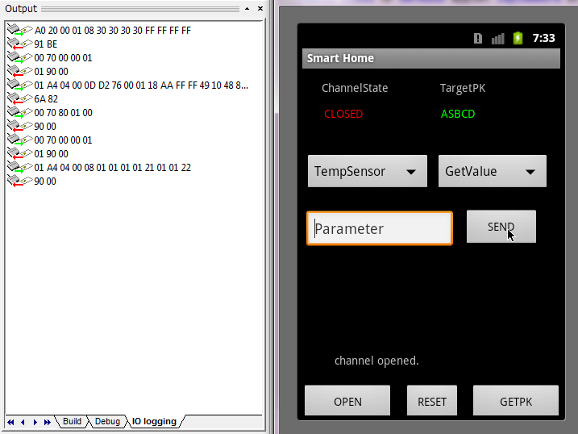
Test: VerfiyPIN and Select Appelt

Slide 8
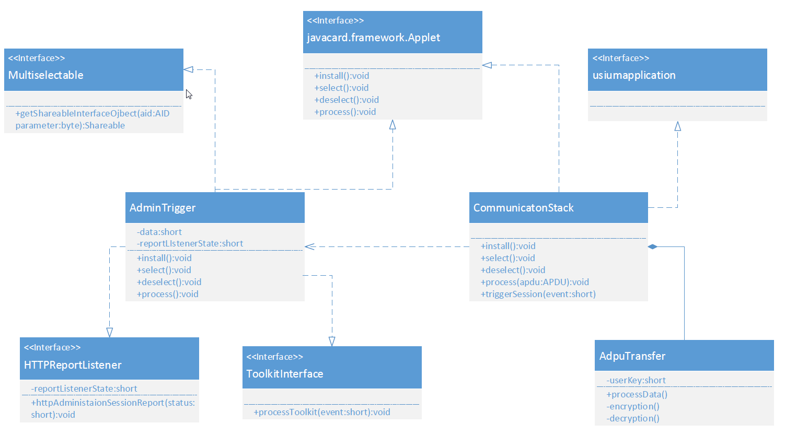
System Design: Applet Class
CommunicationStack:
AdminTrigger
ApduTransfer

Slide 9
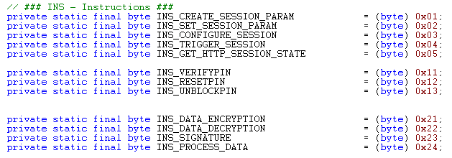

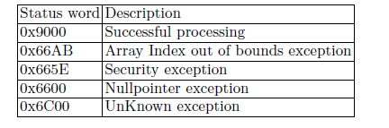
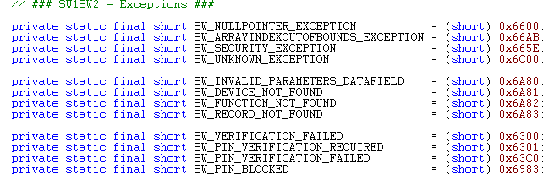
System Design: CAD-SD Interface

Slide 10
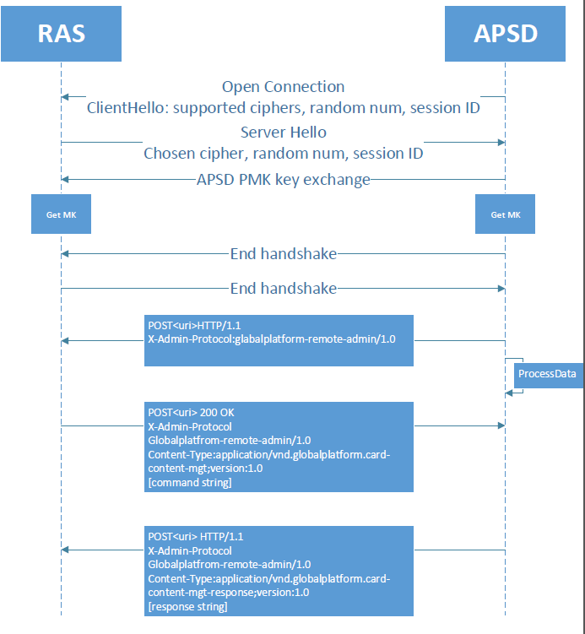
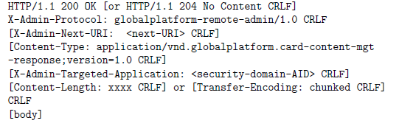
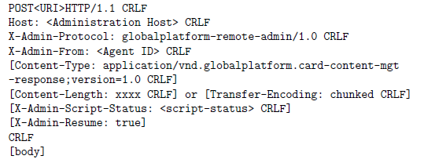
System Design: Communication Flow

Slide 11
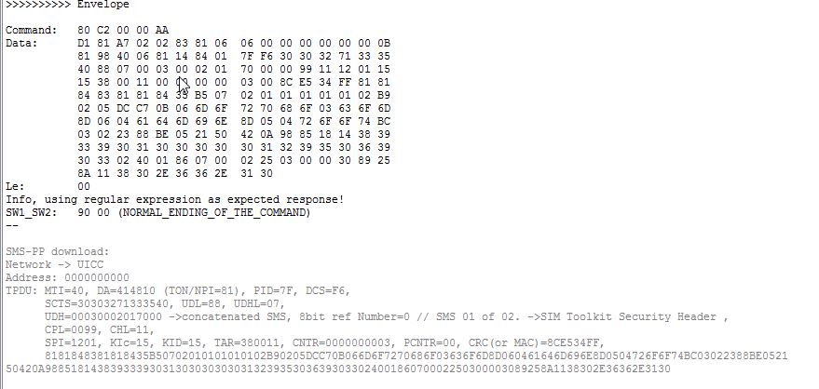
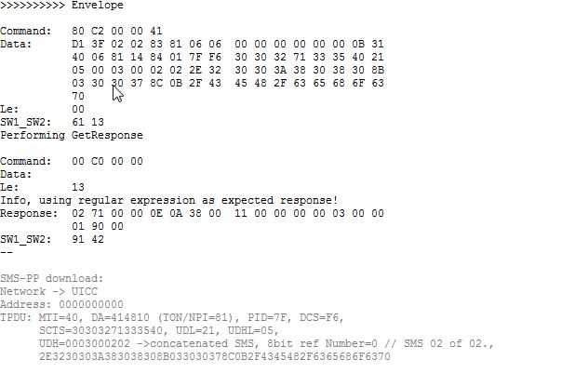
Test: Successfully Receive Trigger SMS

Slide 12
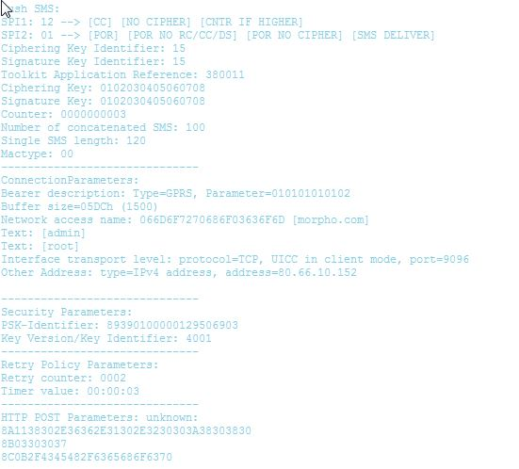
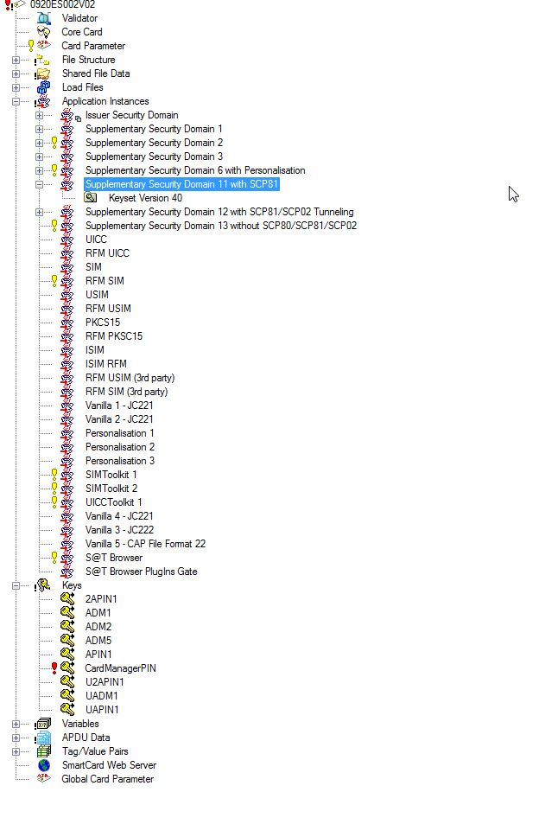
Test: Successfully Receive Trigger SMS

Slide 13
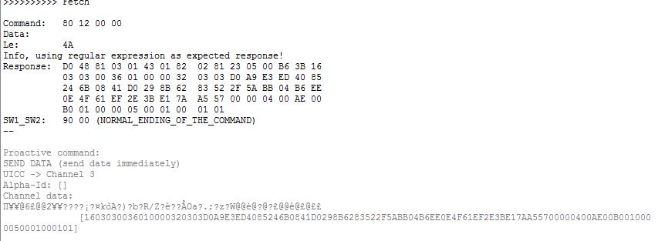
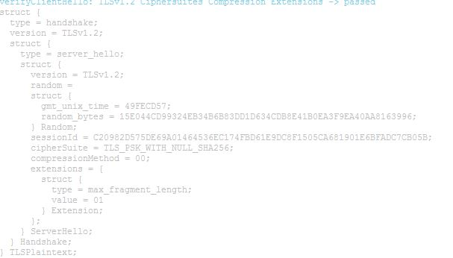
Test: Client Hallo and Server Hallo

Slide 14
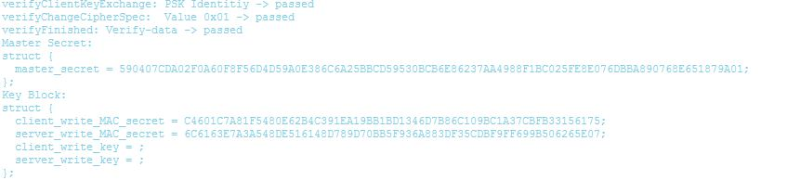
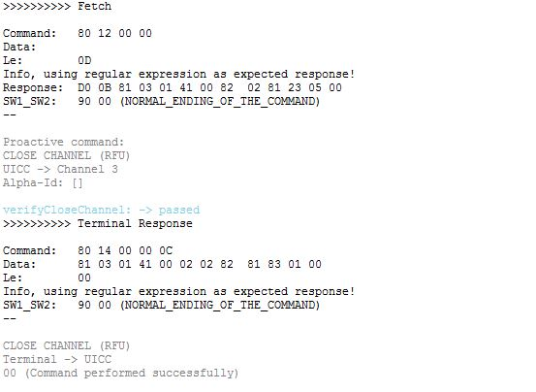
Test: Successfully Generate MK and Close Channel

Slide 15
Security Concerns
Overall System Design Security Concerns:
Authorization, Confidentiality, integrity and etc.
Traceability
Appropriate Timeouts
Rate Limiting and Flow Control
Random Number Generation
CAD-Applet Security:
Authentication: SE Access Control from GlobalPlatform
Secure Messaging: OpenMobile API
Appelt-Appelt Security:
RAM/RFM standard from GlobalPlatform
TLS1.2 based communication session
PKI

Slide 16
Thank you! Question?

